Slide 1

ACCESS CONTROL MAP
June 2024

Slide 2
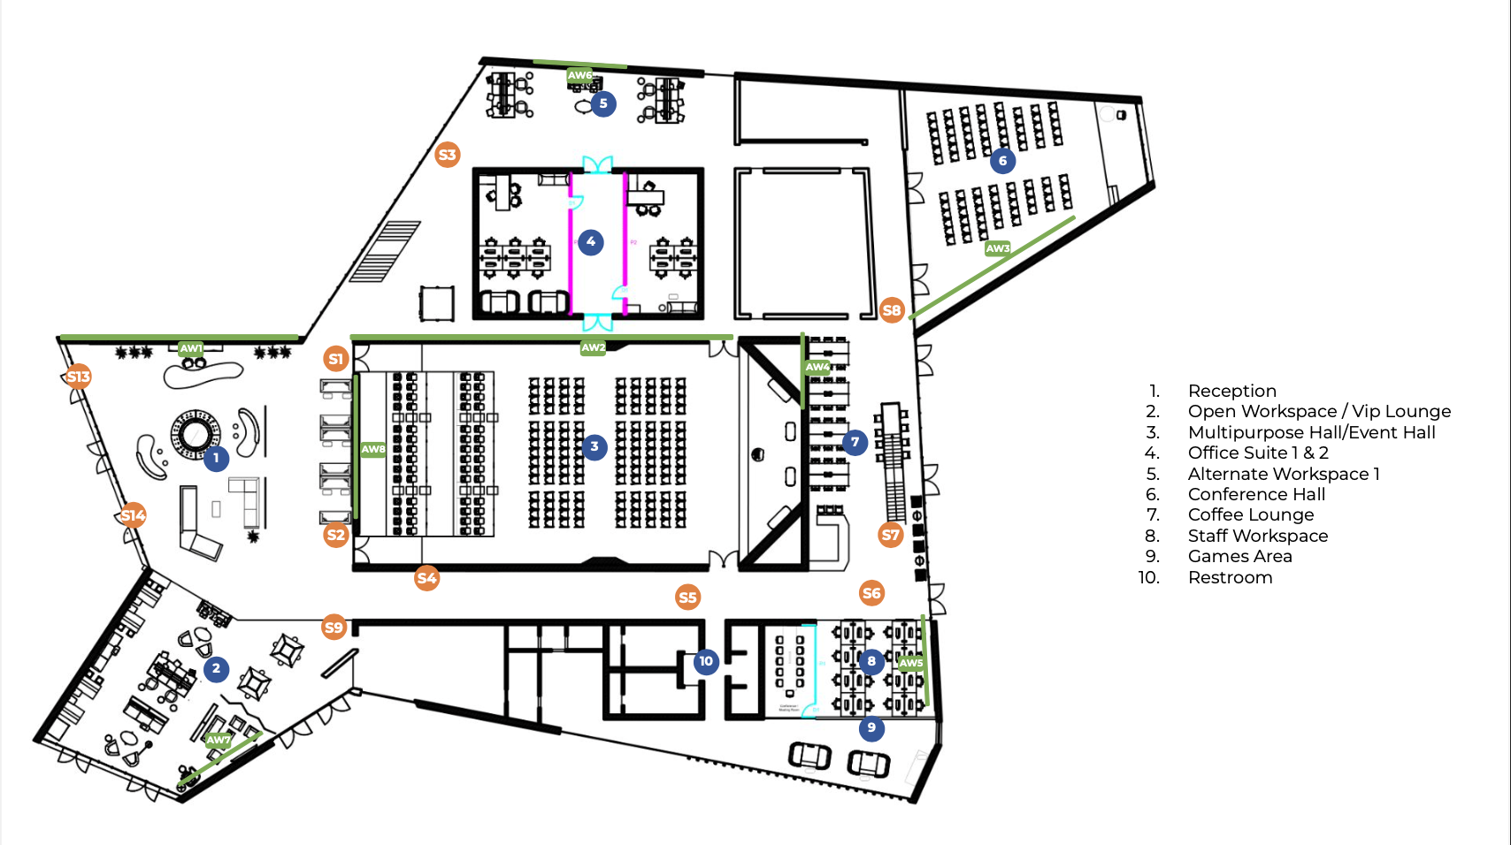
Ground Floor
21
14
10
17
18
15
1
12
1
13
16
1-4 Main Hall
6 VIP Lounge
7 Cafeteria
8 Staff Offices
9 Meeting Room
10 Offices Entrance West
11 Offices Entrance East
12 Office Suite 1
13 Office Suite 2
14 IT Room
15-16 Pitch Hall
17-20 Office Suite 3
21 Office Suite 4
11
19
20
1
3
2
2
4
6
8
7
9
Door Lock
Turnstile Reader
Elevator Reader

Slide 3
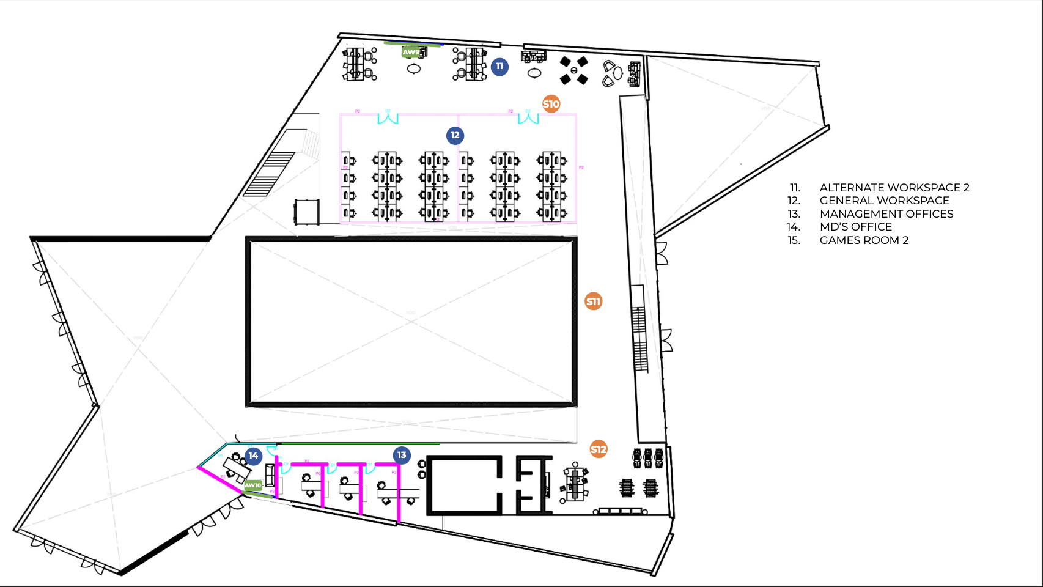
First Floor
22
23
1
1
22-23 General Workspaces
24-26 Private Offices
27 MDs Office
2
27
26
25
24
Door Lock
Turnstile Reader
Elevator Reader

Slide 4
Totals
Door Locks
27
Turnstile Readers
2
Elevator Reader
1

